Slide 1
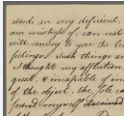
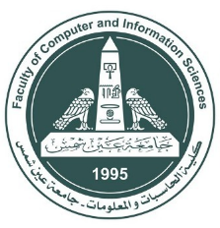
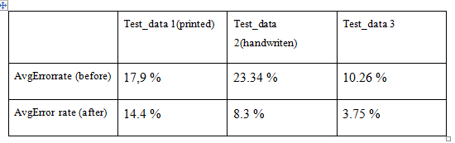
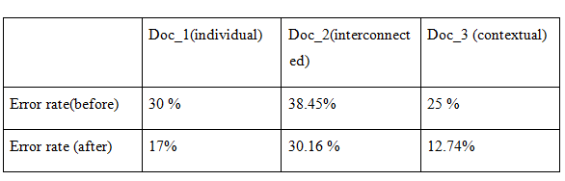
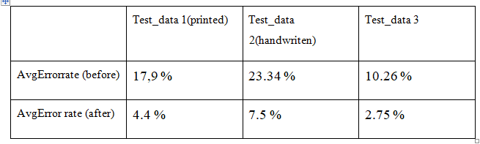
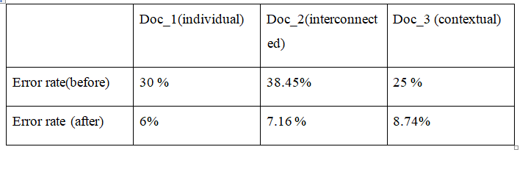
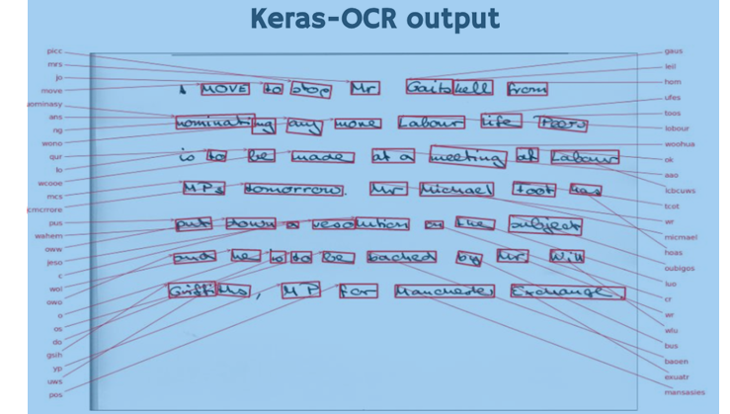
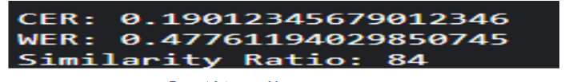
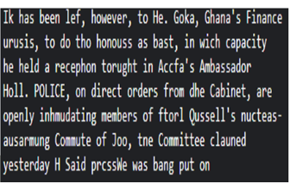
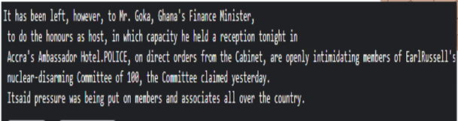
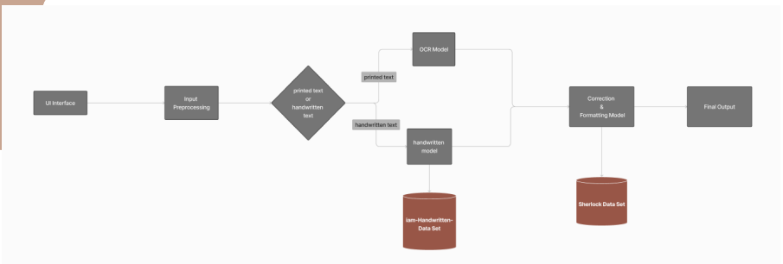
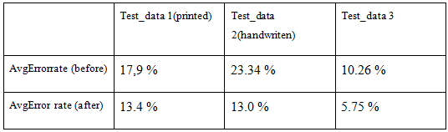
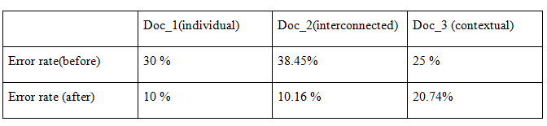
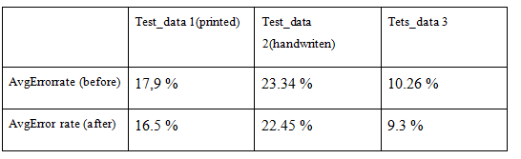
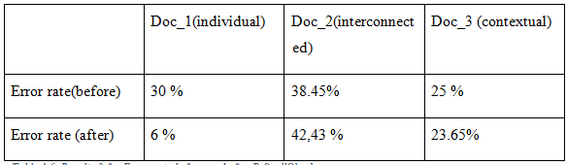
Advanced Ocr and Handwriting System with Correction
By: Riham Mohammed Hassan , Rahma Ali Ali Ali , Mohammed Essam Mohammed , Omar Sherif Soliman , Sara Mohammed Abd-Elmonaem, Moamen Said Mohammed
Supervised by: Dr. Ahmed Ezzat
Ain Shams University
Faculty of Computer & Information Sciences
Information Systems Department
Introduction
Methods
Results
JamSpell
Optical Character Recognition (OCR) is a transformative technology that converts text from images or scanned documents into machine-readable data. This process enhances efficiency, facilitates data analytics, and integrates seamlessly into modern workflows. OCR plays a crucial role in various industries, such as finance, healthcare, legal, and education, streamlining processes and improving accessibility.
The problem with traditional OCR systems lies in their limitations in recognizing and extracting content from handwritten text. Inaccuracies and misinterpretations often occur without smart correction algorithms. Our goal is to address these challenges by developing an OCR system that demonstrates proficiency in accurately recognizing both printed and handwritten text.
Machine learning Our project employs a multifaceted approach, including image preprocessing techniques like noise reduction and binarization to enhance image quality, advanced text detection methods to identify text regions within complex images, and a combination of traditional OCR and modern algorithms to ensure effective recognition of both printed and handwritten text. Additionally, the system integrates multiple correction models to enhance accuracy by rectifying spelling errors and refining outputs., which is beneficial to:
Improve data entry efficiency.
Enhance digital workflows by accurately processing documents and invoices.
Aid in digitizing handwritten notes, making them searchable and accessible..
In our OCR and handwritten text recognition project, we employed a variety of well-established and customized techniques to ensure efficient and accurate performance. The project consists of three main steps: data input, preprocessing, and OCR model implementation. Below, we describe these methods and procedures in detai:
l-Data Input :We collected a comprehensive dataset of printed and handwritten documents to train and evaluate our models. This dataset includes various printed and handwriting styles to ensure robustness and versatility in our system.
2-Preprocessing: is crucial to enhance image quality and prepare data for accurate text recognition by OpenCV2,NumPy,HandwrittenImagePreprocessin.
3.-OCR Model Implementation:Techniques employed in OCR model implementation by Handwritten Text Recognition Models: Pytesseract, Keras-OCR, and Easy-OCR, EAST Model. ext Correction Methods:Various methods were integratedfortextcorrection,including:TextBlobPySpellCheckerJamSpellSymSpellCombined Approach utilizing SymSpell, JamSpell, and PySpellChecker for robust text correction.
. As shown in Figure 1.
Our integrated system showcases substantial advancements in OCR accuracy and reliability, combining traditional and modern techniques to reduce error rates and enhance text recognition across diverse documents. By leveraging OpenCV2 and NumPy for preprocessing, alongside Pytesseract and the EAST model for text detection, we achieved efficient identification and extraction of text regions. This setup proved effective in enhancing image quality through noise reduction and binarization, crucial for accurate OCR performance.For OCR, we utilized Pytesseract for printed text and integrated Keras-OCR and Easy-OCR for handwritten text, employing their pretrained capabilities to achieve high accuracy. Text correction was optimized using multiple libraries such as TextBlob, PySpellChecker, and JamSpell, improving the fidelity of extracted text.
Our Android application, developed in Flutter for broad compatibility, provides a seamless user experience, meeting the demands of industries like business, education, and healthcare where precise text digitization is essential. This project demonstrates the efficacy of combining diverse methodologies to create a robust solution for OCR and handwritten text recognition, setting a benchmark for future developments in this field.In summary, our system delivers enhanced OCR capabilities through meticulous integration of preprocessing, advanced models, and correction techniques, addressing critical needs for accurate and efficient text recognition across various sectors.To measure the error rate by comparing the number of incorrect words to the total number of words in the text, you can define a metric called Word Error Rate (WER). In this context, WER is slightly different from the traditional usage, focusing on the proportion of incorrect words to the total words. The formula for this metric can be defined as:
WER = Number of Incorrect Words/Total Number of Words
The combination of three models
Conclusion
In Advanced OCR and handwritten text recognition systems are transformative, bridging accessibility gaps for the visually impaired and enhancing efficiency across industries by automating document management. Digitizing cultural artifacts preserves heritage and enables broader access to historical records, fostering deeper insights. In AI, OCR fuels innovation by providing datasets for sophisticated algorithms. For businesses, OCR improves operational efficiency and customer service, while in education, it supports inclusive learning environments. Overall, these technologies promise a more connected, efficient, and inclusive future.The current system has a few drawbacks that could potentially have fixes in the future:
1) Enhanced Accuracy and Speed: Continued improvement in accuracy and speed of OCR algorithms to handle diverse fonts.
Multimodal Integration: Integration with other modalities like speech recognition and image processing.
Integration with AI and Machine Learning: Leveraging AI and machine learning techniques to enhance OCR capabilities.
Accuracy Measures
Figure 2 . Pytesserect Accuracy Measurement
Figure 3. Keras-OCR output
Figure 4. Output example
Figure 5. Ground truth
References
[1]Christian Bartz, Hendrik Rätz, and Christoph Meinel, "Handwriting Classification for the Analysis of Art-Historical Documents," Hasso Plattner Institute, University of Potsdam, 14482 Potsdam, Germany, Nov. 4, 2020.
[2]Yuning Du, Chenxia Li, Ruoyu Guo, Xiaoting Yin, Weiwei Liu, Jun Zhou, Yifan Bai, Zilin Yu, Yehua Yang, Qingqing Dang, and Haoshuang Wang, "PP-OCR: A Practical Ultra Lightweight OCR System," Baidu Inc, Oct. 5, 2020.
[3]Chengwei Zhang, Yunlu Xu, Zhanzhan Cheng, Shiliang Pu, Yi Niu, Fei Wu, and Futai Zou, "SPIN: Structure-Preserving Inner Offset Network for Scene Text Recognition," 1Shanghai Jiaotong University, China; 2Hikvision Research Institute, China; 3Zhejiang University, China, Oct. 25, 2021.
[4]unlong Li, Yiheng Xu, and Tengchao Lv, "DiT: Self-supervised Pre-training for Document Image Transformer," Shanghai Jiao Tong University, Shanghai, China, and Microsoft Research Asia, Beijing, China, July 19, 2022.
[5]Atman Mishra, A. Sharath Ram, and Kavyashree C., "Handwritten Text Recognition Using Convolutional Neural Network," Dept. of AIML, New Horizon College of Engineering, Bangalore, India, Jul. 1, 2023.
[6]Tianlun Zheng, Zhineng Chen, Bingchen Huang, Wei Zhang, and Yu-Gang Jiang, "MRN: Multiplexed Routing Network for Incremental Multilingual Text Recognition," School of Computer Science, Fudan University, China, and Shanghai Collaborative Innovation Center of Intelligence, July 30, 2023
[7]Y. Bengio, P. Y. Simard, and P. Frasconi. Learning longterm dependencies with gradient descent is difficult. NN, 5(2):157–166, 1994. 3
[8]S. M. Lucas, A. Panaretos, L. Sosa, A. Tang, S. Wong, R. Young, K. Ashida, H. Nagai, M.Okamoto, H. Yamamoto, H. Miyao, J. Zhu, W. Ou, C. Wolf, J. Jolion, L. Todoran, M. Worring, and X. Lin. ICDAR 2003 robust reading competitions: entries, results, and future directions. IJDAR, 7(2- 3):105–122, 2005
[9]A. Graves, S. Fernandez, F. J. Gomez, and J. Schmidhu- ber. Connectionist temporal classification: labelling unsegmented sequence data with recurrent eural networks. In ICML, 2006.
[10]Baek, Y.; Lee, B.; Han, D.; Yun, S.; and Lee, H. 2019. Character region a wareness for text detection. In Proc. CVPR, 9365–9374. Chng, C. K., and Chan, C S. 2017. Total-text: A comprehensive dataset for scene text detection and recognition. In Proc. ICDAR, 935–942.
Figure 1 . Methods and Procedures Used
PySpellCheer
Symspell

